Slide 1
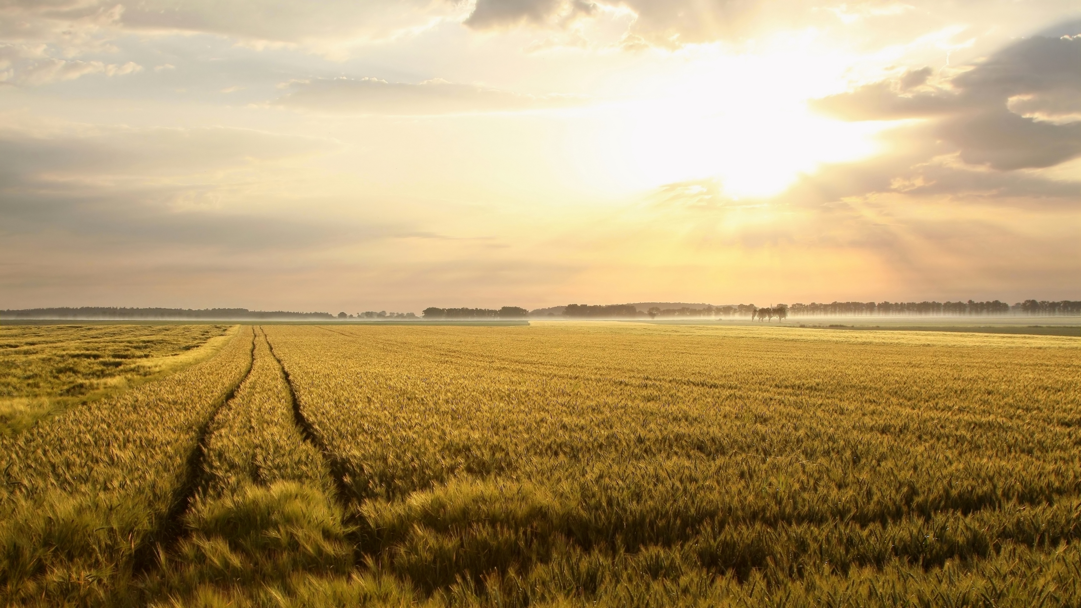
Climate change and Food in the UK - it is not just about Diet
A joy of life
A climate change mess
An opportunity for all of us to do something positive

Slide 2
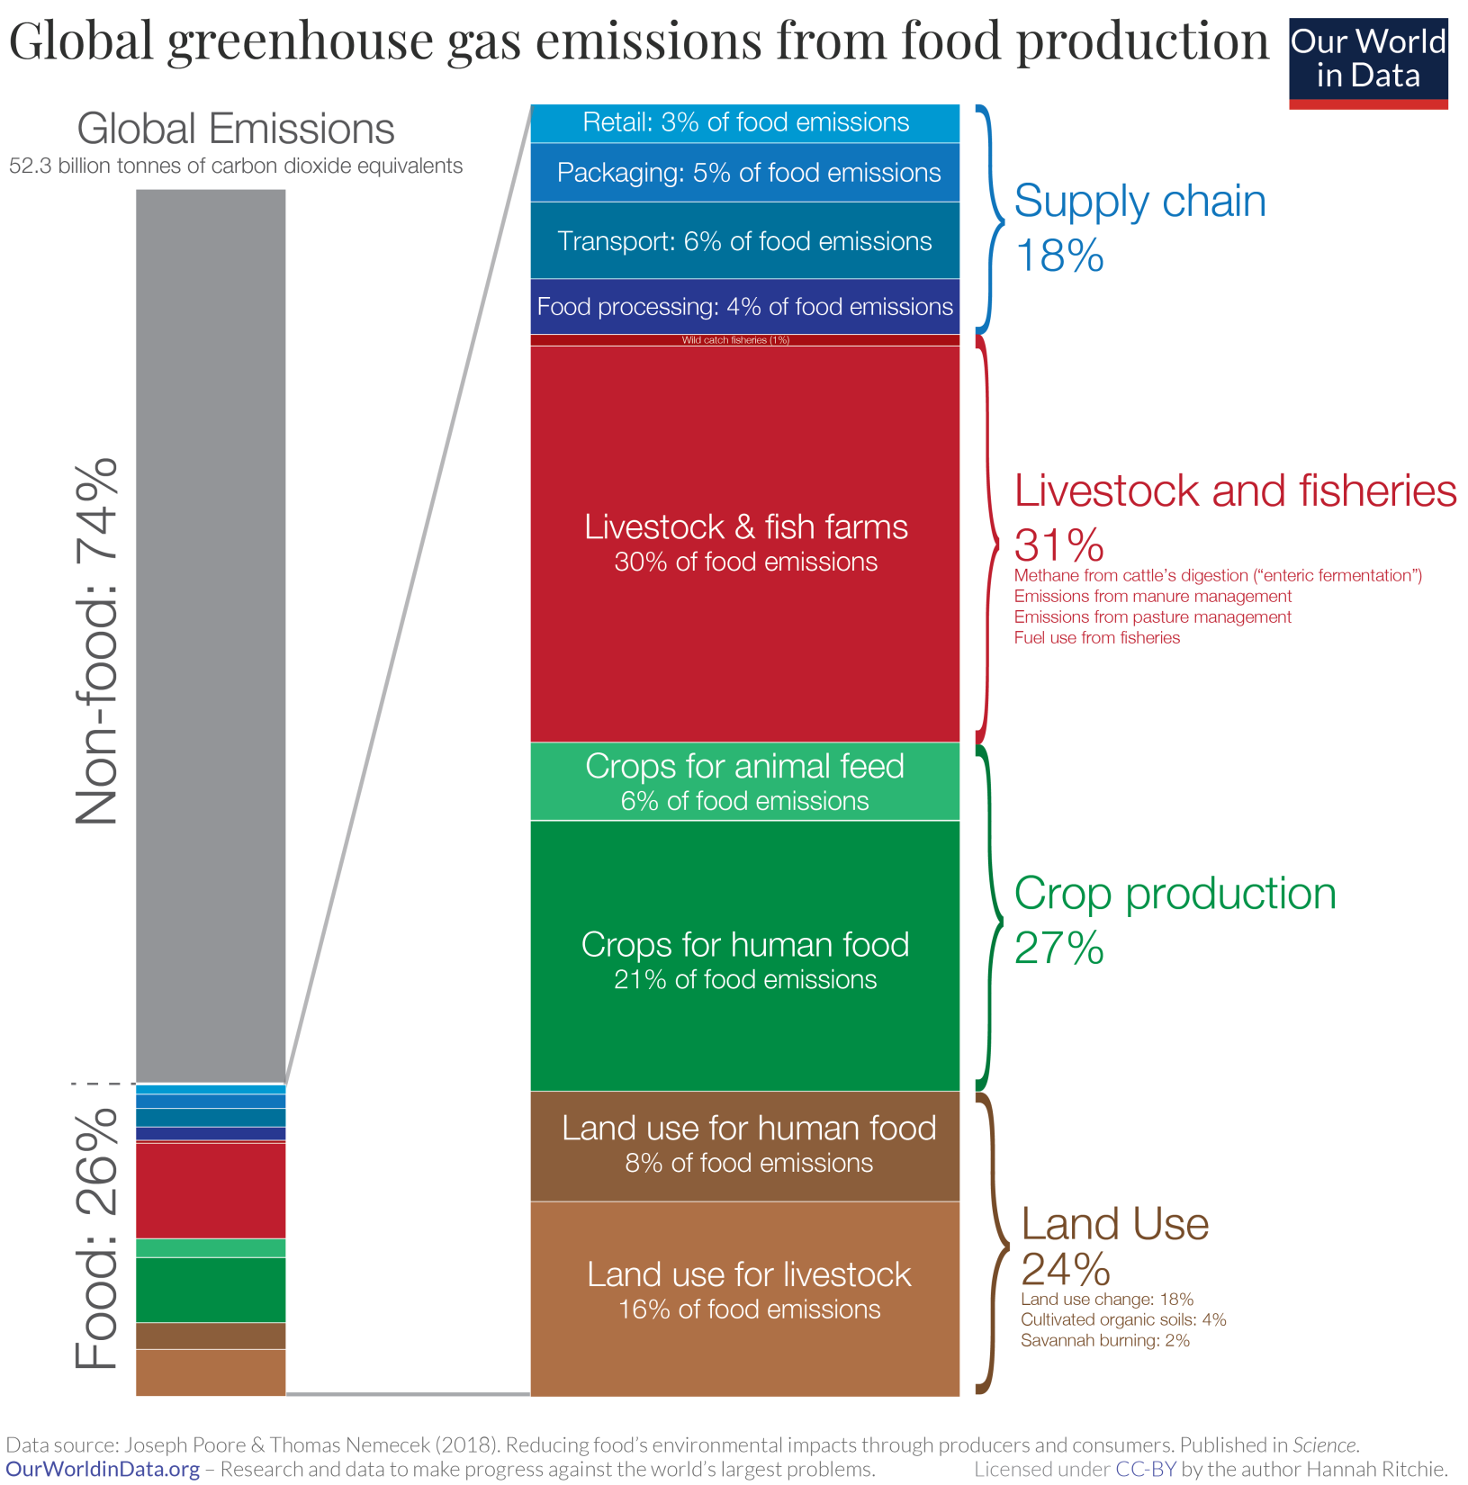

Slide 3
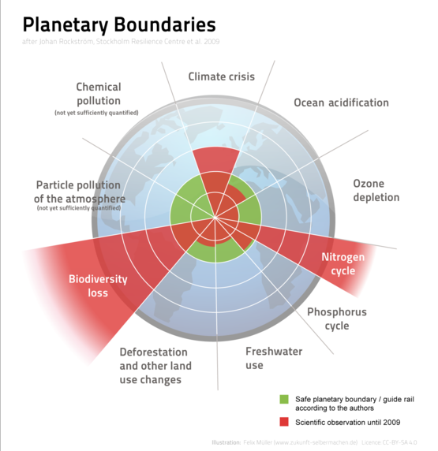
The Nine Planetary Boundaries
2009 study by a group of Earth system and environmental scientists, led by Johan Rockström from the Stockholm Resilience Centre

Slide 4
Tim Lang > professor of food policy at London’s City University, > a consultant to the World Health Organization, > special adviser to four House of Commons select committee inquiries and > a food policy adviser to the Department for Environment.
a depleted agriculture sector which produces only around 50% of the food we actually eat,
of the six million hectares of cultivatable land in Britain, only 168,000 hectares (3%) are used for fruit and vegetables.
As a result, we have to import vast amounts of crops we could otherwise be growing.
Much of the remaining land is used for crops to feed livestock or for processed foods.
using production methods which are damaging to the environment and human health
Food is the biggest driver of NHS spending as a result of obesity, diabetes and heart disease
“although not officially at war, the UK is, de facto, facing a wartime scale of food challenge”

Slide 5
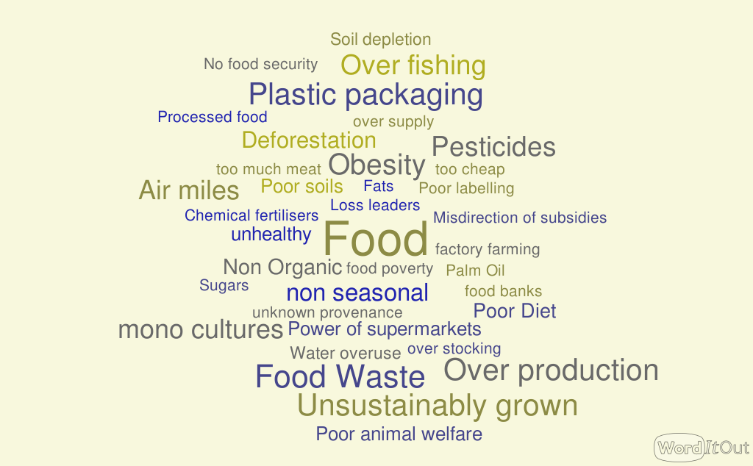

Slide 6
sugar makes up 13.5% of 4- to 10-year-olds; the official recommendation is <5%
8% of teenagers meet the 5 A Day recommendation for fruit and vegetables
Gut health
Sugars
Unknown Provenance
average fibre intake in adults is 19g per day, well below the recommended 30g per day
Poor Diet
Poor diets associated with 11 million deaths worldwide according to the Lancet Global Burden of Disease Study
Processed Foods
Saturated Fats
According to the UNFAO, the average minimum daily energy requirement is about 1,800 kilocalories; UK = 2,313
Obesity
Too much Meat
Overall the study found that the largest number of diet-related deaths were associated with eating too much sodium and not enough wholegrain

Slide 7
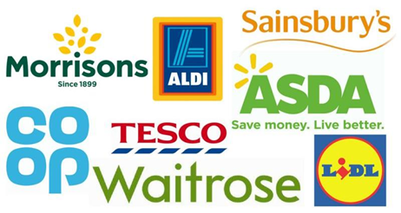
feedbackglobal.org
Over stocking
Just eight companies control 90% of our food supply. “It’s the ‘leave it to Tesco’ approach,”
Food miles
Single use Plastics
Packaging accounts for 67% of plastic waste
Monopoly
Poor labelling
Super-markets
Loss Leaders
Out of season
The prioritisation of price has hollowed out UK agriculture, so that primary producers get the smallest slice of the cake. They get about 5% or 6% of the value of the food we buy. They need double that. Tim Lang
Cheap food
Food Aesthetics
Perishable fruit or veg out of season means it has travelled by air.

Slide 8
https://www.ted.com/talks/tristram_stuart_the_global_food_waste_scandal#t-122852
Sell by dates
Over Production
Use by dates
Too Cheap
Subsidies
Food Waste
Large Portions
Too much Meat
Poor storage
Food Aesthetics

Slide 9
Just three crops (wheat, rice and maize) account for more than 60% of the calories consumed by 7 billion people across the world.
Livestock are inefficient convertors of food. Feeds 900 million people using crops that could feed 3 billion people
Factory Farming
Mono-cultures
Too much meat
Ave. number of pesticide sprayings in UK wheat crop is 22
Over Fishing
Pesticides
Poor Farming Practices
Britain is responsible for the highest quantity of over-fishing in Europe over the last two decades..
Deforestation
Synthetic Fertilisers
Nitrous oxide is 265 times more potent than CO2
Water over use
Soil depletion
If current rates of soil degradation continue all of the world's top soil could be gone within 60 years
70% of global freshwater usage is by agriculture

Slide 10
Smaller portions
Stop Snacking
Milkman
Less
Pay more if you can
Refill shops
Stop using or challenge super-markets
Shop to a list
Local butcher/ baker/ greengrocer
Online bulk foods
Freeze don’t Throw
Single use plastic alternatives
Local
Buy UK
Write to them
Less Meat
Home Composting
How I reduced the impact of my food shopping on the planet
Buy seasonal
Home grow more
What you eat is more important than where it comes from.
Organic
Reduce Processed foods
Free range
Support / Sign up to Campaigning orgs.
Kitchen cupboard Audit
Cook from scratch
Grass fed red meat
Cut the sugar
means
less pesticides, less synthetic fertiliser, less water usage, soil improvement
wider range of ingredients to improve gut health

Slide 11
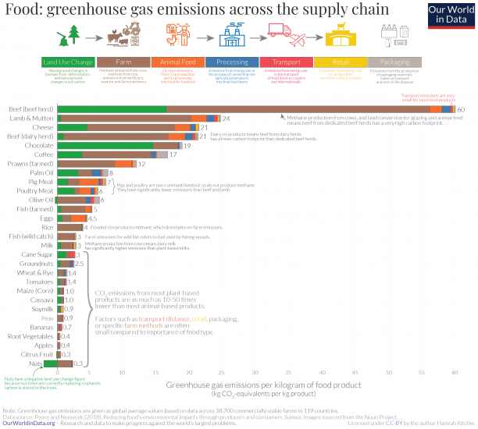
Kg CO2 per kg food

Slide 12
There’s no hope without action
Greta Thunberg 2021
FEEDBACK – various food campaigns
https://feedbackglobal.org/campaigns/supermarket-food-waste-scorecard/
ourworldindata.org [University of Oxford]
https://www.soilassociation.org/ The Soil Association
https://www.pan-uk.org/ Pesticide Action Network
https://www.mcsuk.org/ Marine Conservation Society
https://www.ethicalconsumer.org/ Ethical Consumer
Any Questions?

